Slide 1

UNIVERSITY COLLEGE OF ENGINEERING, ANNA UNIVERSITY , BIT CAMPUS TIRUCHIRAPALLI
NUMBER PLATE DETECTION AND RECOGNITION SYSTEM
GUIDE: PRESENTED BY, Mr.N.KATHIRVEL R.ANUPREETHI
M.ASMATH BEGUM

Slide 2
OUTLINE
ABSTRACT
OBJECTIVE
INTRODUCTION
LITERATURE SURVEY
PROPOSED SYSTEM
SYSTEM ARCHITECTURE
MODULES
EXPERIMENTAL RESULT
REFERENCES

Slide 3
ABSTRACT
Number plate recognition play a vital role in security management such as surveillance operations.
The Number plate must be in format according to given by government.
ANPR system recognize the alphanumeric in the number plate using image processing technique.

Slide 4
OBJECTIVE
Provide accurate alphanumeric by number plate detection and recognition system using image processing technique.

Slide 5
INTRODUCTION
The vehicle number plate is an efficient way to identify vehicle, which is unique for each vehicle.
There are four separate processes
preprocessing
localization
segmentation
number plate recognition.

Slide 6
LITERATURE SURVEY
S.NO | TITLE | AUTHOR | YEAR | TECHNIQUES | BENEFITS
1. | Eyes on the target : super resolution and license plate recognition in low quality surveillance videos | Hilario seibel | 2017 | Image processing (Super resolution) | It provides high accuracy
2. | License number plate recognition system using entropy-based features selection approach with SVM | Muhammad Attique khan, Muhammad Sharif | 2017 | SVM | Best to deal with different problems of light variations, occlusion of image

Slide 7
S.NO | TITLE | AUTHOR | YEAR | TECHNIQUE | BENIFITS
3. | Algorithm for License Plate Localization and Recognition for Tanzania Car Plate Numbers | Isack Emmanuel Bulugu | 2013 | Object enhancement (MAT LAB) | traffic monitoring systems and all kind of intelligent transport system.
4. | An effective method for plate number recognition | Jia Wang , Boris Bacic , Wei Qi Yan | 2017 | Digital image processing | Automated parking attendant

Slide 8
PROPOSED SYSTEM
Pytesseract 0.2.6
Opencv 3.0

Slide 9
SYSTEM ARCHITECTURE
INPUT
Image
PREPROCESSING
Gray scale conversion
Median filtering
LOCALIZATION
Sub image contain only number plate
OUTPUT
Character
CHARACTER RECOGNITION
Optical Character Recognition
CHARACTER SEGMENTATION
Extracting the number from the image

Slide 10
MODULES
Preprocessing
Localization
Character Segmentation
Character Recognition

Slide 11
PREPROCESSING
Convert RGB image to gray scale image through Gray scale conversion.
Remove noise using median filtering.

Slide 12
LOCALIZATION
The process of identifying number plate from the captured image.
Support Vector Clustering(SVC) algorithm is used to extract the number plate.

Slide 13
EDGE DETECTION TECHNIQUE
SOBEL OPERATOR
Used in image processing and computer vision
It creates an image emphasising edges

Slide 14
OF SOBEL OPERATOR
EXAMPLE
100 | 100 | 200 | 200
100 | 100 | 200 | 200
100 | 100 | 200 | 200
100 | 100 | 200 | 200
-1 | 0 | 1
-2 | 0 | 2
-1 | 0 | 1
-100
-200
-100
+200
+400
+200
=400
Size of the kernel
Size of the original image
Result of multiplication of original image and kernel

Slide 15
CHARACTER SEGMENTATION
Process of partitioning a digital image into multiple segment(set of pixels)
GOAL:
To simplify or change the representation of an image into more meaningful.

Slide 16
RECOGNITION
Ability of software to identify object, place, people, writing and action in image.
Optical Character Recognition (OCR) Technique is used to recognize the alphanumerics in the number plate

Slide 17
Level 0:
Character Recognition
Image
character
Level 1
Localization
Segmentation
Image
Character
Recognition

Slide 18
Level 2
Preprocessing
Plate region extraction
Image
Extracted image
Level 3
Extracted image
Row segmentation
Column segmentation
Segmented character
Level 4
Segmented character
Recognition using OCR
Display Character

Slide 19
EXPERIMENTAL RESULT

Slide 20
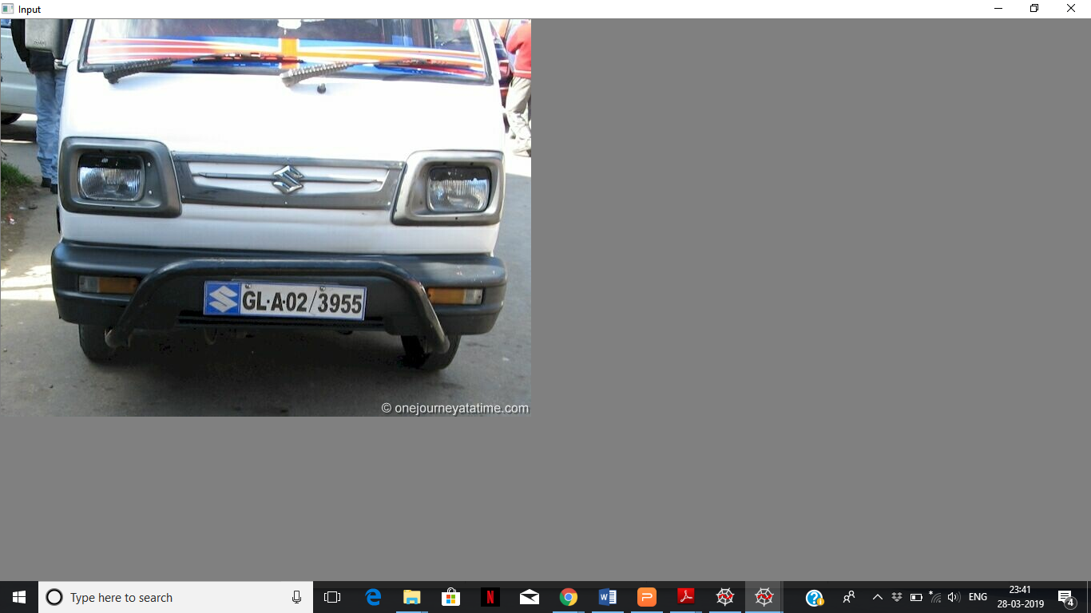
System captures the image and send to the preprocessing stage to enhance
the quality of image

Slide 21

The process of RGB to Gray Scale Convertion has been done using threshold value. It is also known as Thershold image

Slide 22

Here localization process has been done through binary image convertion

Slide 23
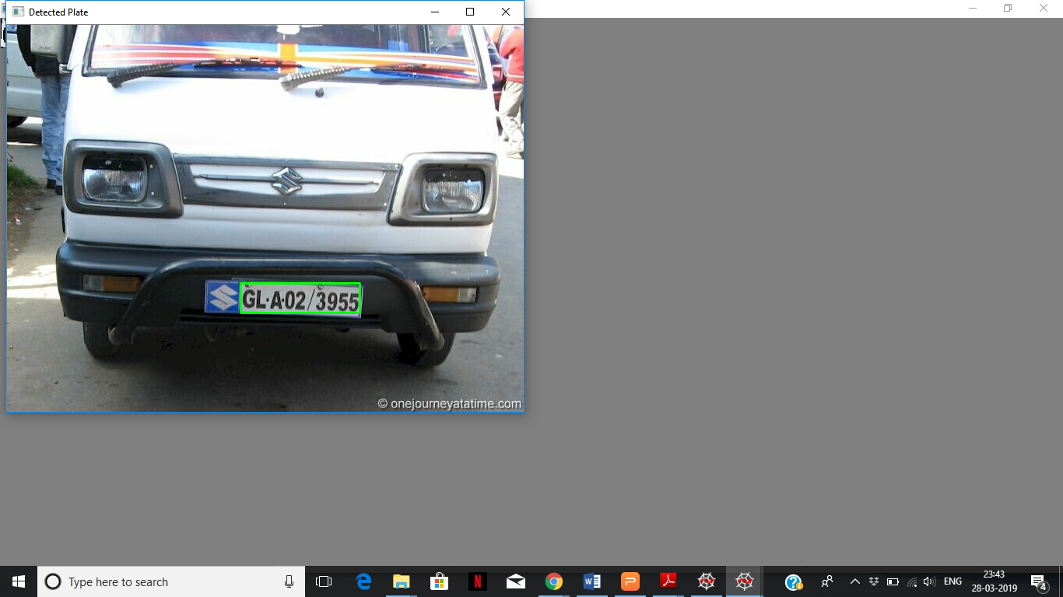
Detecting the number plate using image processing technique.

Slide 24

The alphanumerics of the number plate were detected and displayed using Optical Character Recognition technique.

Slide 25
REFERENCES
S. Du, M. Ibrahim, M. Shehata, and W. Badawy, Automatic license plate recognition (ALPR): A state-of-the-art review,'' IEEE Trans. Circuits Syst. Video Technol., vol. 23, no. 2, pp. 311_x0015_325, Feb. 2013
W. Shi et al., ``Real-time single image and video super-resolution using an ef_x001C_cient sub-pixel convolutional neural network,'' in Proc. IEEE Conf. Compute. Vis. Pattern Recognit. (CVPR), Jun. 2016.

Slide 26
C. Dong, C. C. Loy, K. He, and X. Tang, ``Image super-resolution using deep convolutional networks,'' IEEE Trans. Pattern Anal. Mach. Intell.,vol. 38, no. 2, pp. 295_x0015_307, Feb. 2015.
C. N. E. Anagnostopoulos, I. E. Anagnostopoulos, I. D. Psoroulas,V. Loumos, and E. Kayafas, ``License plate recognition from still images and video sequences: A survey,'' IEEE Trans. Intell. Transp. Syst., vol. 9,no. 3, pp. 377_x0015_391, Sep. 2008.

